Slide 1
Dice
Dr. C.A.P. Smith

Slide 2
Last thought for Assignment 1
How to convert text into a number
Called “parsing”
let’s say you have a String s = “123”
int j = Integer.parseInt(s);

Slide 3


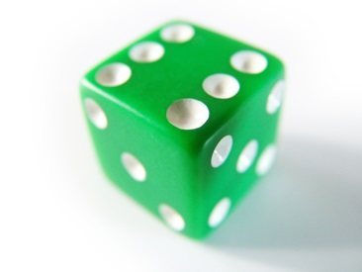
Dice

Slide 4
Random Numbers
import java.util.Random;
public class RandStuff {
public static void main (String[] args) {
Random rand = new Random();
int j = (int) (6*rand.nextDouble() +1);
} // end main
} // end class

Slide 5
Ship, Captain, Crew
Ship
Crew
Captain

Slide 6
Rules
You have 5 dice
You have at most 3 rolls
The goal is to get a Ship, Captain, and Crew
And then as large a total as you can for the other two dice
You must get a Ship before Captain, and Captain before Crew. (or in the same roll)
You keep the dice you want, and roll the remaining dice… But when you roll, you must roll at least two dice.

Slide 7
Example
Keep the Ship, and roll the rest.
You can’t keep the Crew, because you haven’t yet rolled a Captain.

Slide 8
Example, cont.
Keep the Ship, Captain, and Crew
If you have rolls remaining,
Roll two dice, to get a better total than “2”

Slide 9
Example, cont.
Keep the Ship, Captain, and Crew
If you have rolls remaining,
You might decide to roll again, but you have to re-roll both the “6” and the “1”…
You can’t just re-roll the “1” by itself.

